Slide 1
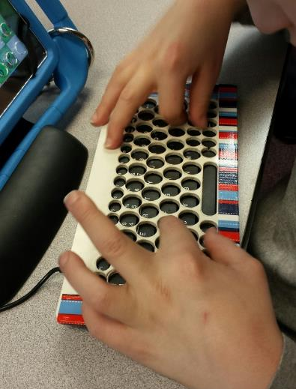
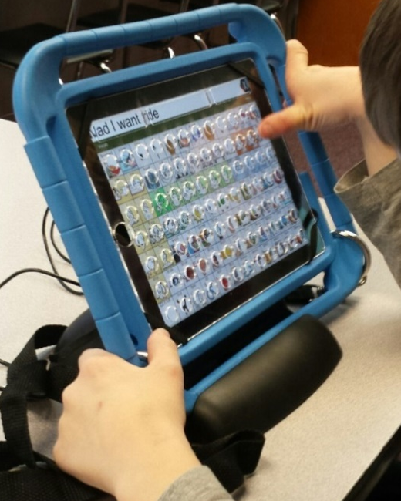
Keyboard covers (Dec 2015)
Allows students with limited fine motor skills to more accurately type on keyboards and IPads.
Cut on the laser engraver.
Designed in Photoshop and Corel Studio.
Comment from therapist: “The keyguards were magnificent!!!! He loved the IPad one!”

Slide 2
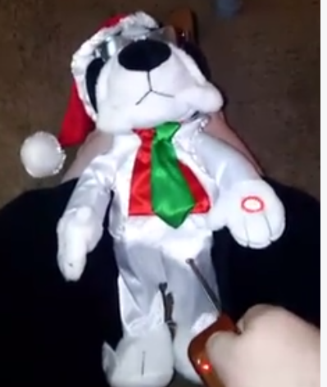
Remote actuation for toy (Dec 2015)
Modifies a typical push-to-activate toy to be operation with a remote control.
A student had complete responsibility for the design and prototype.
Remote control connects to a wireless big button that can actuate an item such as this toy.
Project allowed a student who missed the end of the semester due to a hospitalization to complete the class.

Slide 3
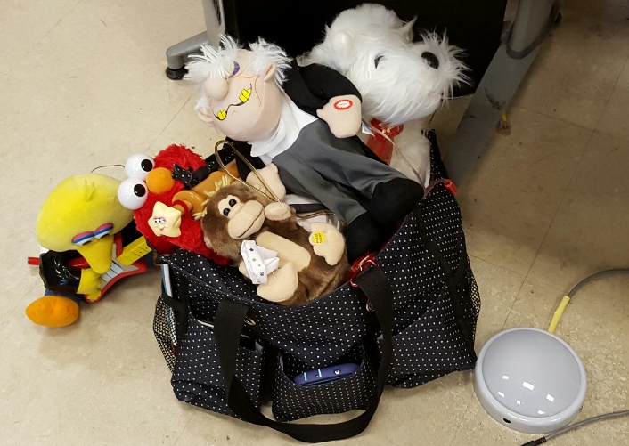
Toy repair (Dec 2015)
Repair adapted toys that no longer work.
Students troubleshoot wiring and electrical components.
Ivy Tech improved the method for those that don’t solder.
Ivy Tech donated parts.
Ivy Tech improved strain relief and electrical isolation for safety, reliability.
Here are toys ready to go back to their owners.

Slide 4
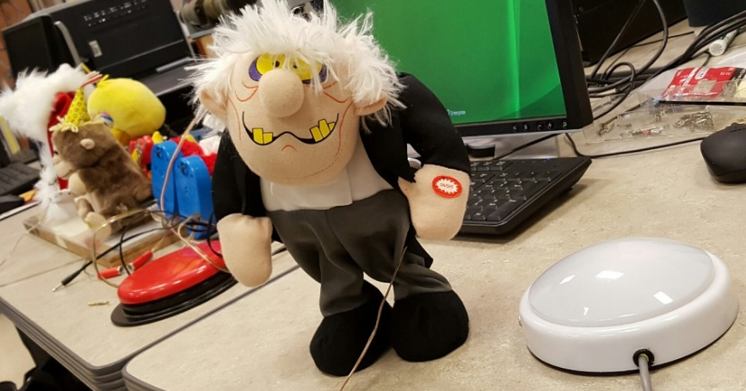
Button design (Dec 2015)
Use inexpensive tap lights to create adaptive buttons.
The red “big button” in the left of the picture is manufactured specifically for people with fine motor skill disabilities. It costs $65.
The button on the right is a re-purposed tap light that was produced for $8.
The tap light was modified to be easier to press and activate from all angles.
Students assisted in the design of this button.

Slide 5
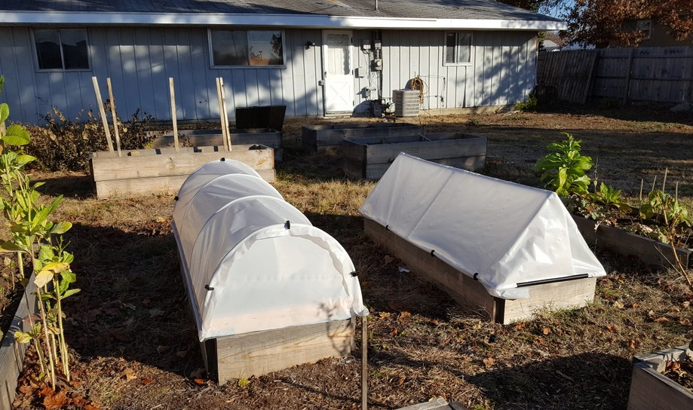
Cold Frame design and build (Sept 2016)
Design and build cold frames based on stated needs from Community Garden leaders.
Students came up with two designs.
Students got practice with power tools and measurements as they made prototypes of their designs.
Cost estimates for building one or ten frames were completed by the students and provided to the Community Garden leaders.

Slide 6
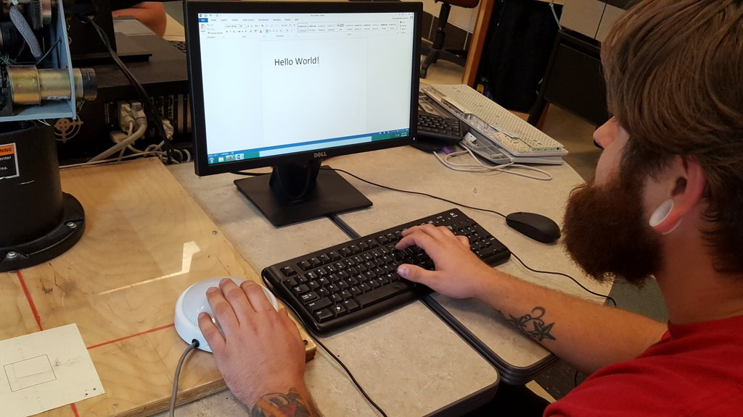
Keyboard external button (Sept 2016)
Design and build a keyboard that uses an external button in place of the shift key for student with limited use of left hand.
Students researched ways to solve the end user’s specific problem.
End user, an Ivy Tech student, tested the keyboards and found they allowed her to type using the shift key. As of Sept 2019 she is still using it!
Student modified two keyboards.

Slide 7
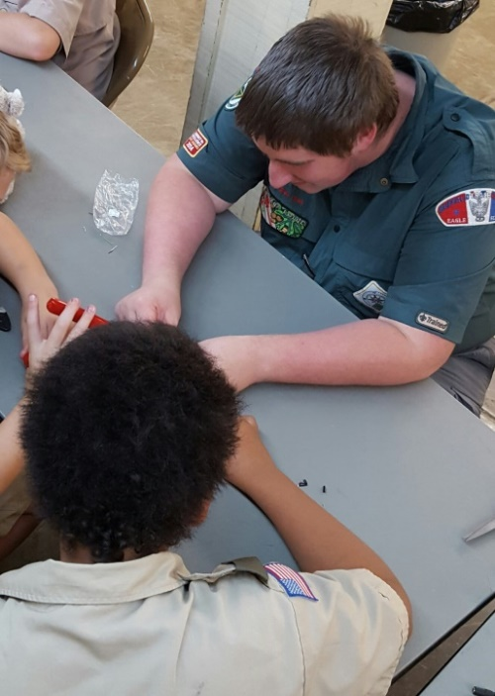
Spreading service work throughout the community (Sept 2016)
Students find opportunities to use the adaptation procedures in other groups looking to do service work.
Approximately 14 scouts helped modify toys that were given to the EVSC’s Adaptive Technology Department.

Slide 8
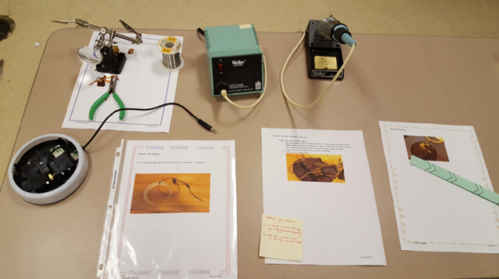
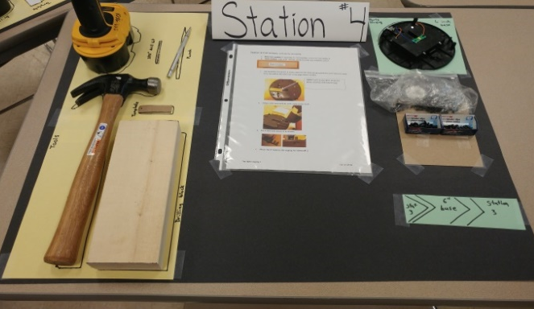
Lean Manufacturing Line (Oct 2016)
Students assemble the big buttons used in adaptive learning while using a modern assembly line design.
Takes the big button design and puts it into stations like would be found in industry.
Teaches students about lean manufacturing, the Toyota Production System, Kanban, JIT, and other manufacturing concepts.
Students work to improve the design of the buttons to make more robust and less expensive designs.
Students work to improve the flow of the assembly.

Slide 9
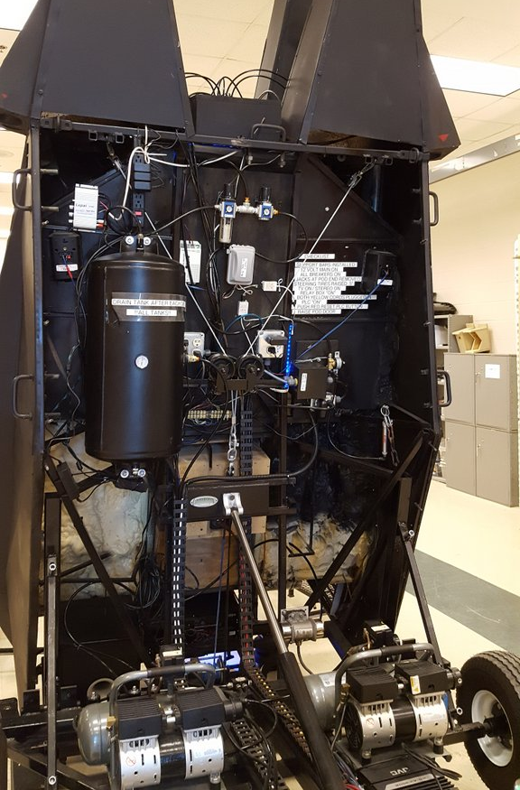
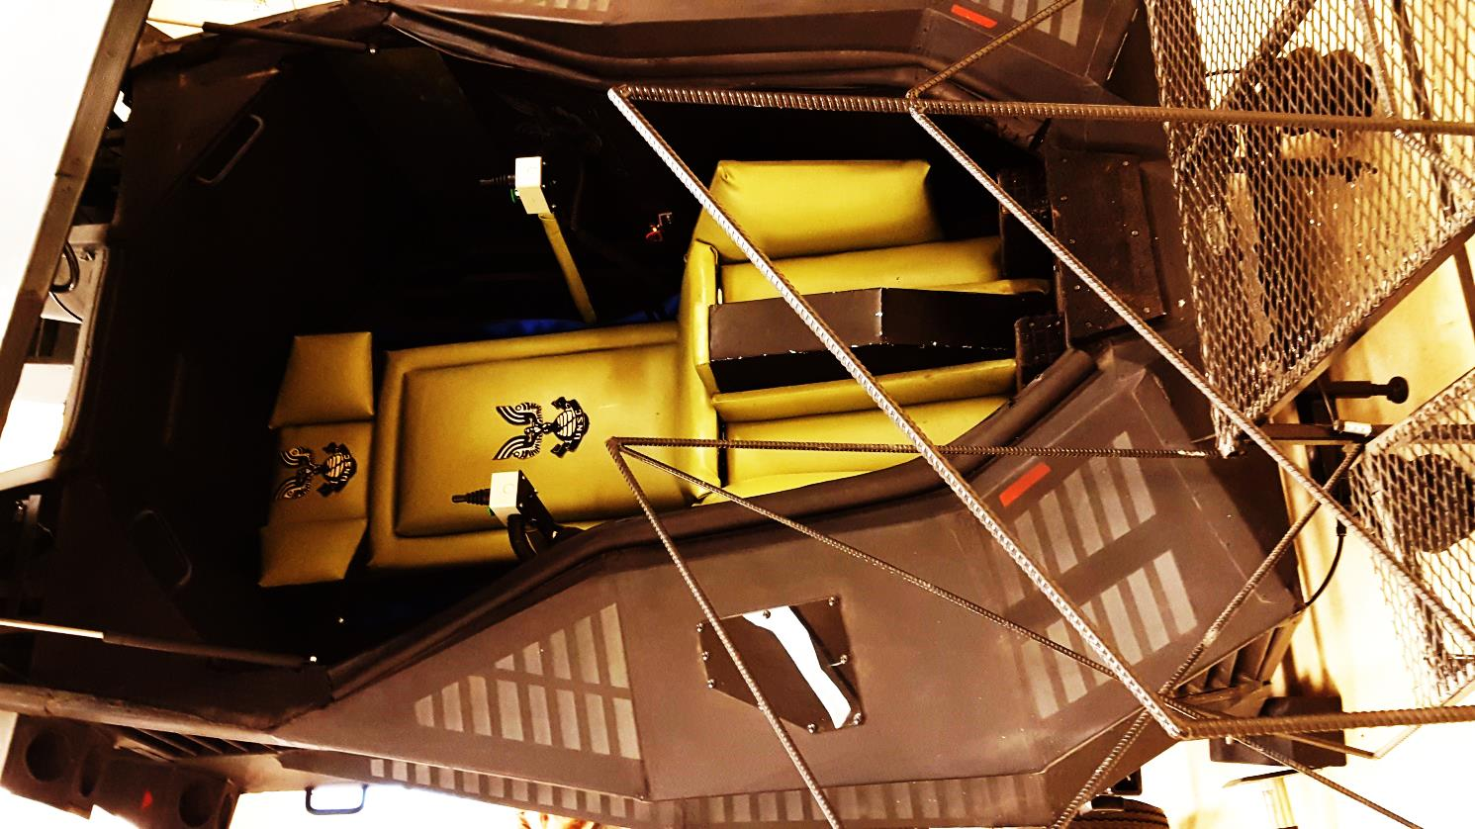
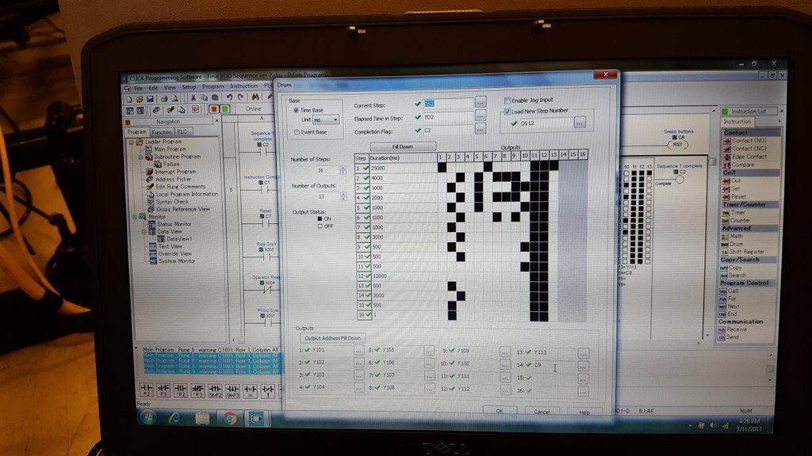
PLC Troubleshooting (Mar 2017)
Ivy Tech was asked to troubleshoot a PLC-operated simulator.
No documentation was available. PLC was a different brand than we had used before.
Several mechanical problems were found in addition to the programming issues.
We fixed it!

Slide 10
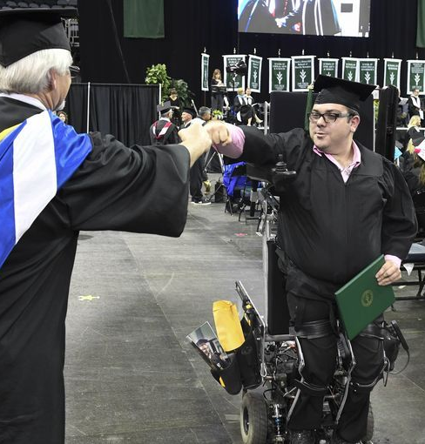
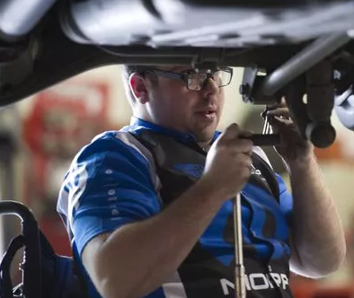
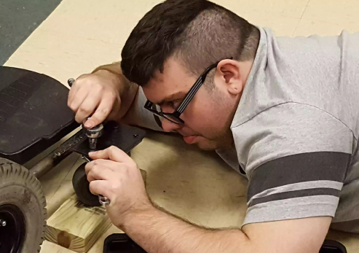
Lift Mechanism for wheelchair (Nov 2016)
Students and the Technology faculty designed and built a wheelchair that allows an automotive student to stand up to work.
Chair was completed in time for Austin to attend the Ivy Tech Gala where he danced the night away and to stand to receive his diploma at his graduation from Ivy Tech.

Slide 11
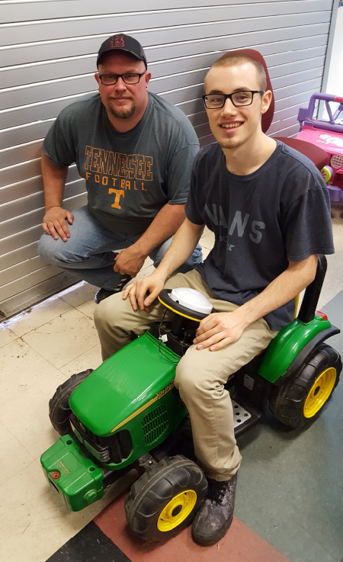
Ride On Vehicles (2017)
For a child with Cerebral Palsy
Child has good use of hands but cannot operate the foot pedal.
Moved the controls to the center of the steering wheel
Worked with wiring circuits with differing voltages.

Slide 12
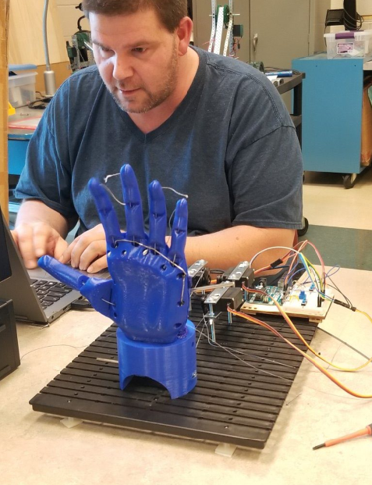
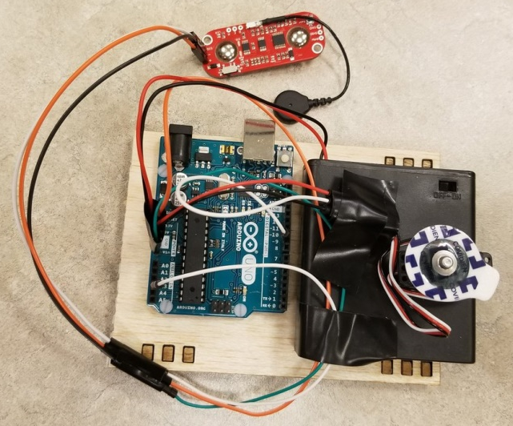
Myoware and bionic arm (2018)
Students studying Arduino in order to actuate a bionic hand
Testing myoware inputs to control the movement of the hand.

Slide 13
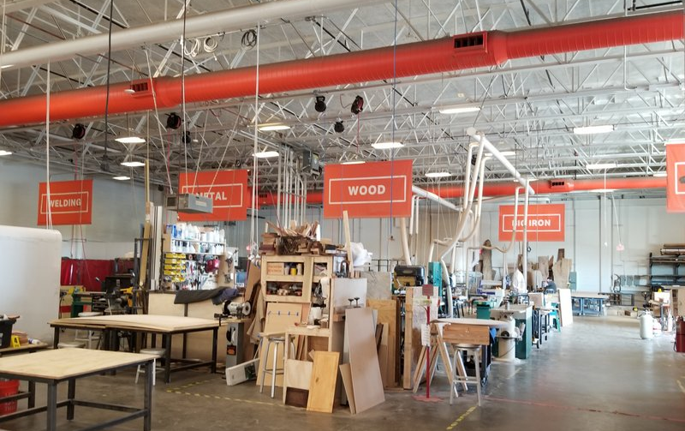
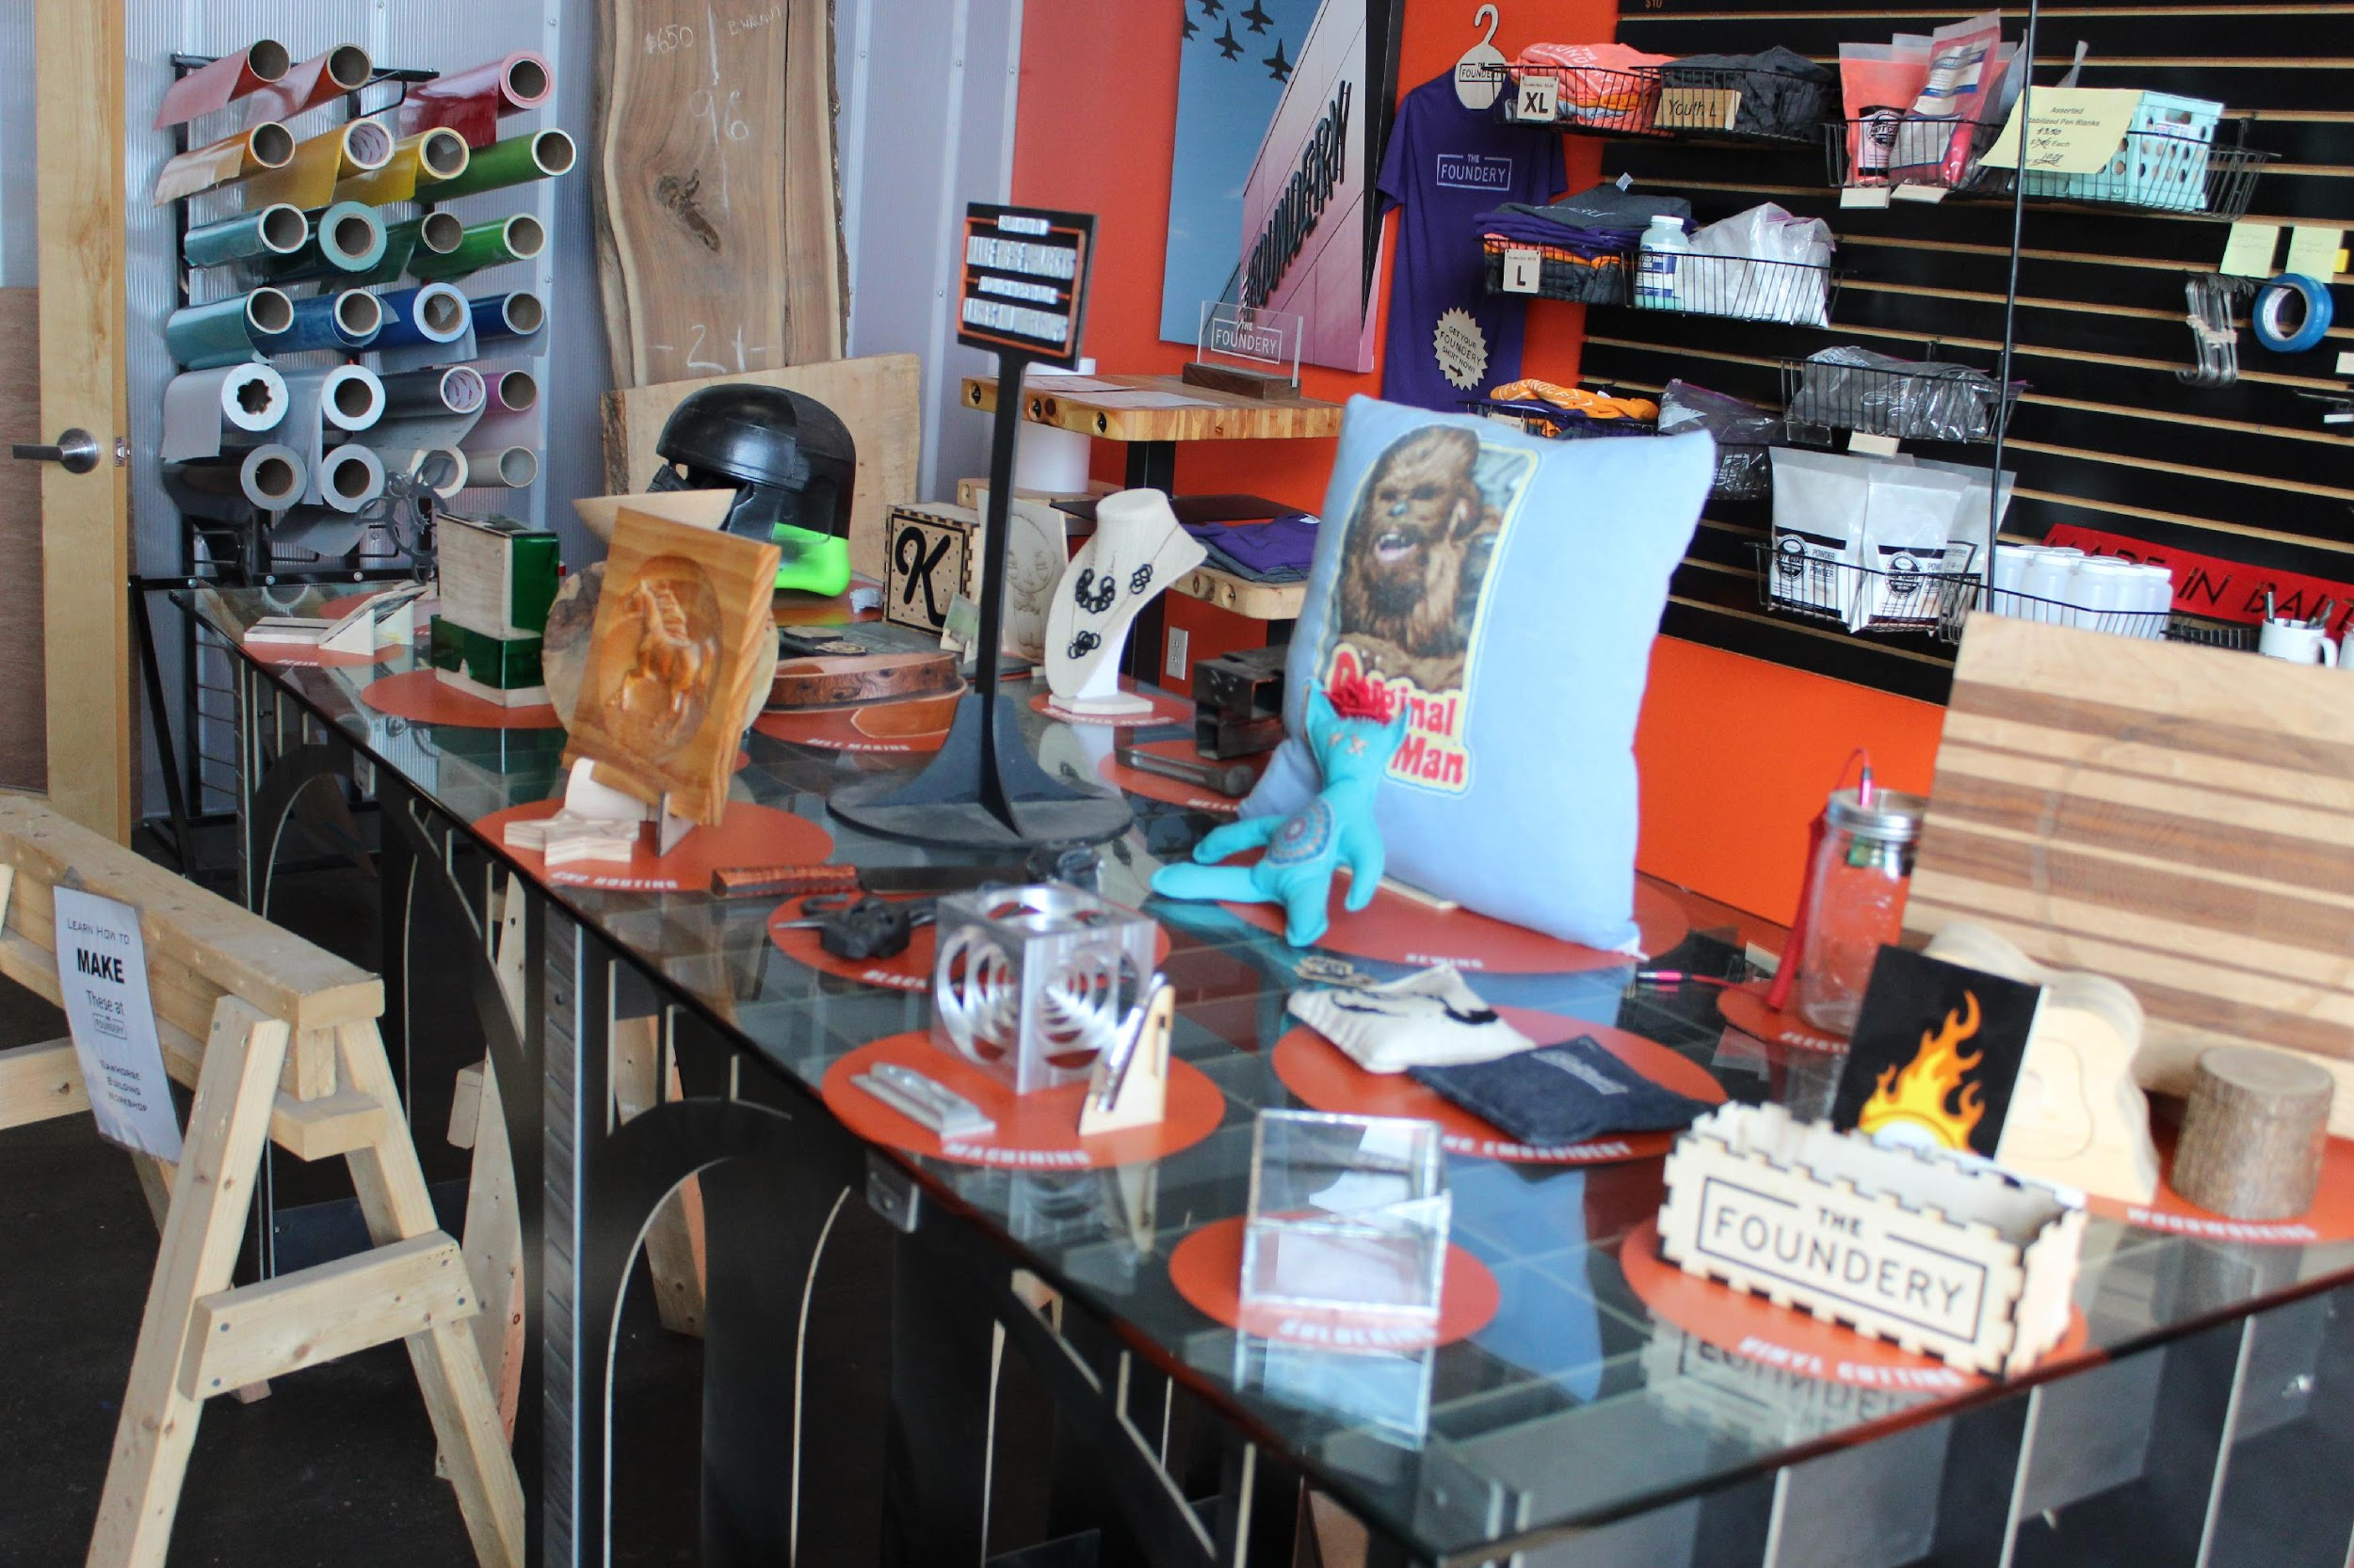
The Foundery
Baltimore MD trip (2018)
Trip to present at a conference included tours of robotics and 3D printing labs and several Makerspaces
Vinyl Cutting
Powder Cutting
Metal Lathe
Wood Lathe
Blacksmithing
Wood Working
CNC Embroidery
CNC
3D Printing
Silk-Screen Printing
Fusion 360
Milling
WaterJet
Leather Working

Slide 14
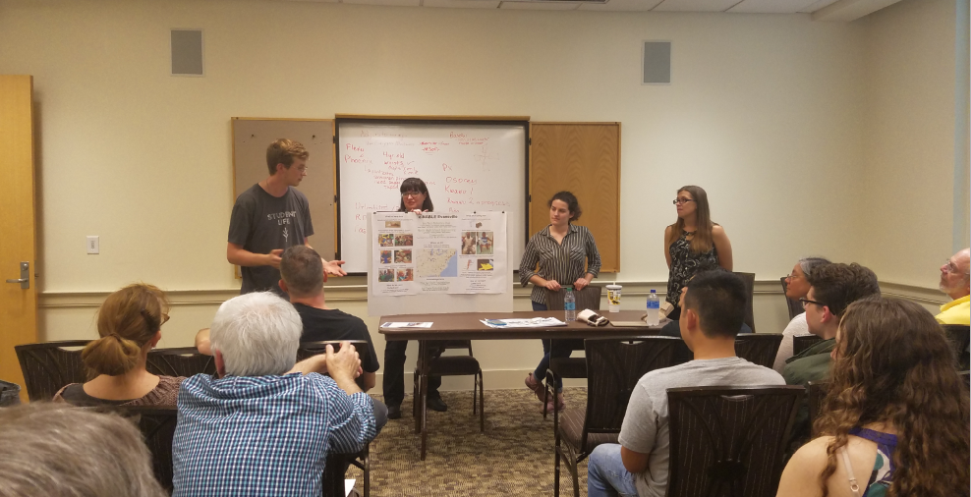
Enable Presentation (2018)
Students and Instructor presented at International conference on 3D printed prosthetics

Slide 15
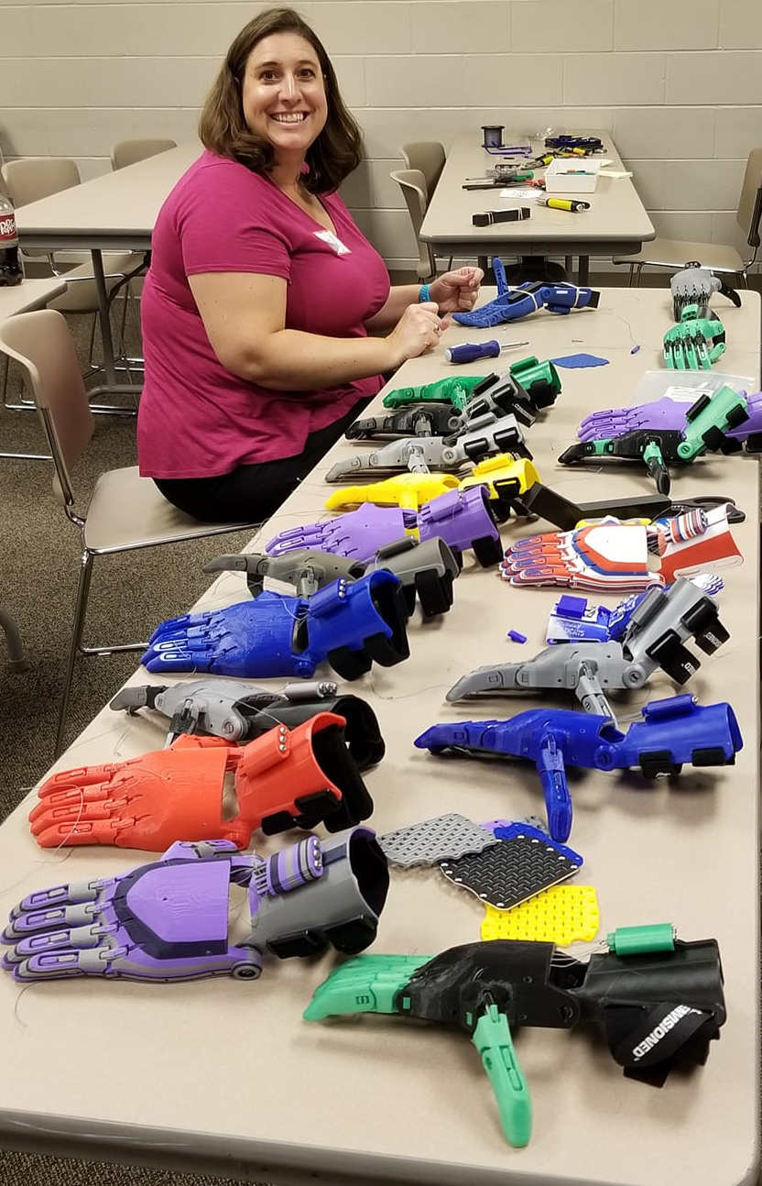
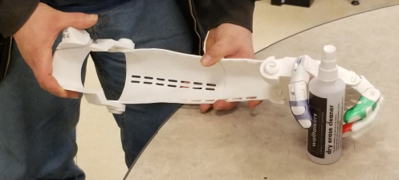
Prosthetic hands (2019)
Learn 3D printing capabilities
3D print lever-actuated hands for people with limb differences.
Summer camp assembled 19 hands donated to Togo, Africa

Slide 16
Prosthetic Design
Jerry’s Fingers

Slide 17
Summer Camp (2019)
Solar Cars
Battlebots
3D Printing
Laser Cutting
Renewable Energy
Making of prosthetics

Slide 18
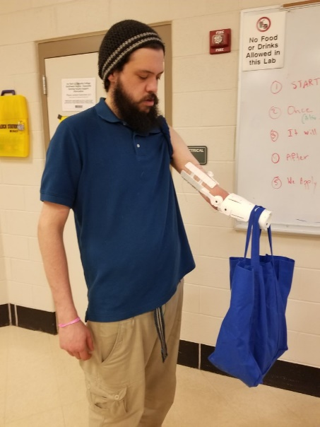
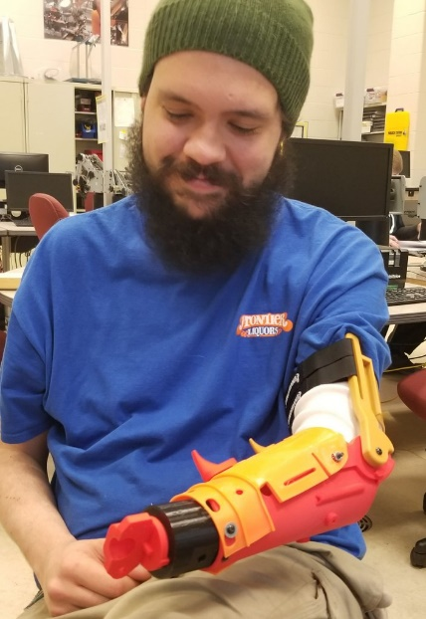
Load testing (2019)
Design a 3D printed prosthetic for strength
Build Load Testing fixture
Load test various prosthetic designs

Slide 19
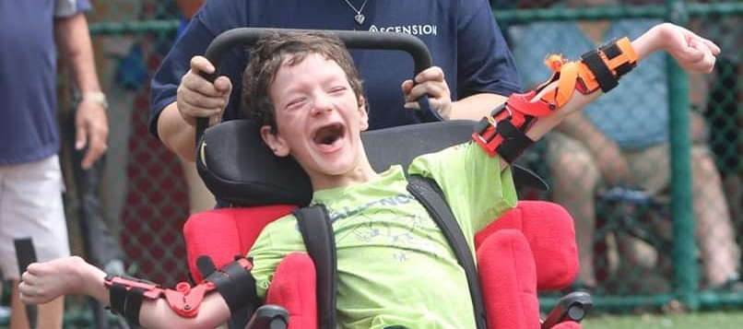
Freedom Arms (2019)
For a child with Lesch-Nyhan syndrome – causes him to scratch his face.
Had to have his hands tied to the chair so he would not hurt himself
Students designed splints that keep him from being able to reach his face
This design allows him to have his arms free

Slide 20
Community Outreach (2019)
Boys and Girls Club
Fix their 3D printer
3D printing lessons
YWCA
3D printing lessons
Caze, Evans, Caldwell
Weekly Robotic Club activities

Slide 21
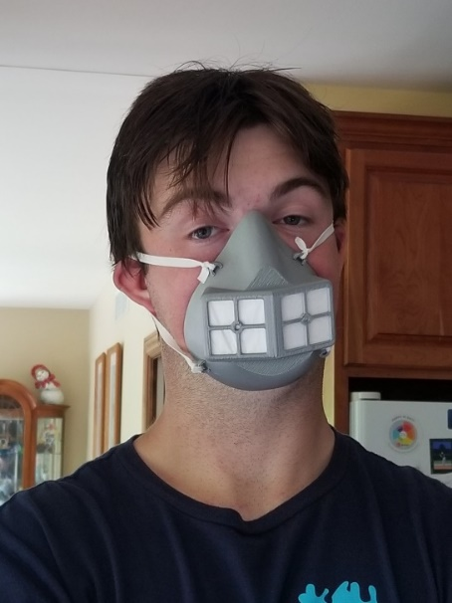
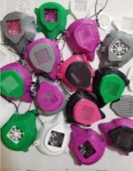
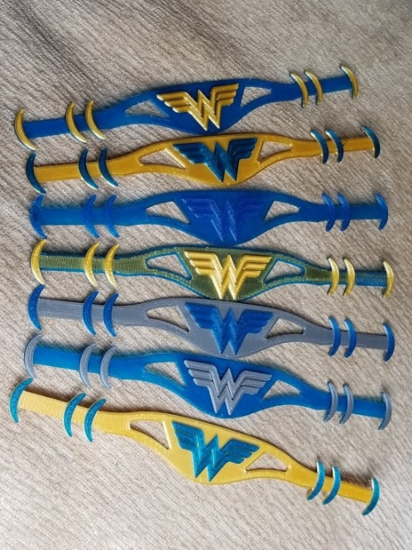
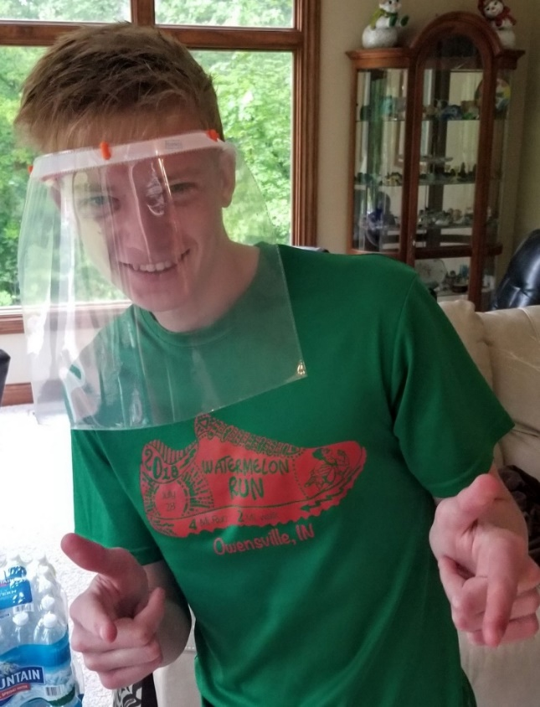
Covid-19 Protection (2020)
Over 2000 items made for donation by volunteers

Slide 22
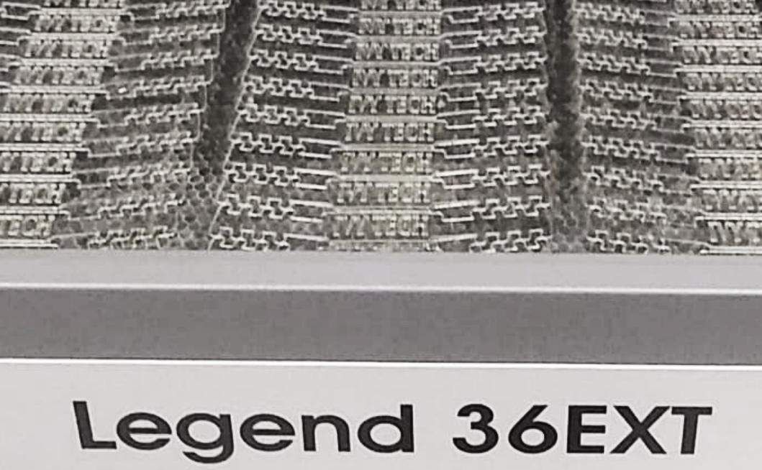
Covid-19 Protection(2020)
Laser cut ear savers
Production went from 3 an hour to 100 an hour.

Slide 23
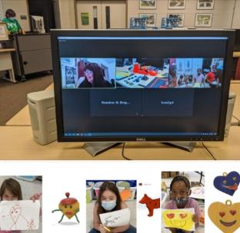
Distance Camp (2020)
Meet in person and via Zoom as conditions allow.
Showcase technology that makes distance learning possible as well as fun.
Presented to international audience about how to reach students when times are tough.
Partnerships with YMCA, Bits & Bytes, Boys and Girls Clubs.

Slide 24
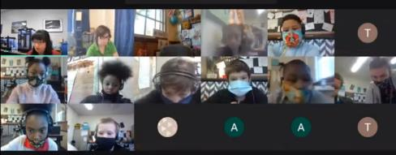
Distance Camp (2020)
Continue to reach out to students in under-served areas in spite of Covid lockdown
Zoom-based camps
Virtual tours of Ivy Tech
Keep in contact with students previously met in camps
Provide community service opportunities
Invite as mentors

Slide 25
How can you get involved?
Write to me: dzimmerm@ivytech.edu
Ask your leaders
Research on your own

